Slide 1
Data Mining
Model Overfitting
Introduction to Data Mining, 2nd Edition
by
Tan, Steinbach, Karpatne, Kumar

Slide 2
Classification Errors
Training errors (apparent errors)
  Errors committed on the training set
Test errors
  Errors committed on the test set
Generalization errors
  Expected error of a model over random selection of records from same distribution

Slide 3
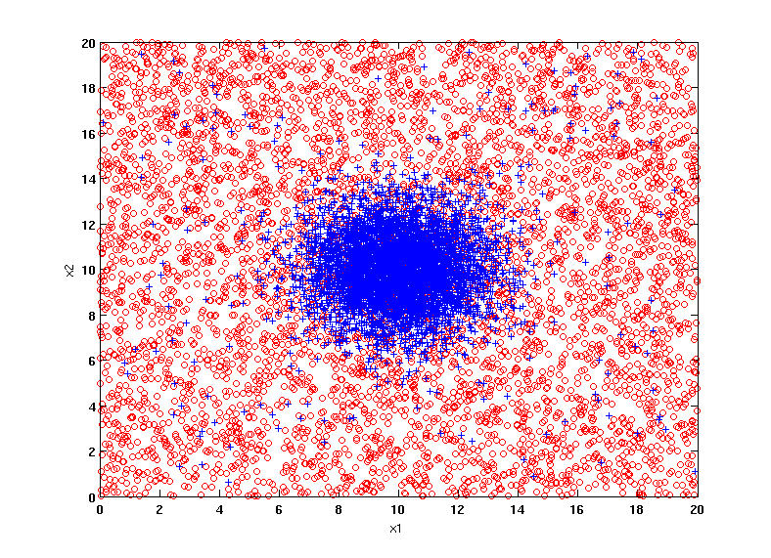
Example Data Set
Two class problem:
+ : 5200 instances
5000 instances generated from a Gaussian centered at (10,10)
200 noisy instances added
o : 5200 instances
Generated from a uniform distribution
10 % of the data used for training and 90% of the data used for testing

Slide 4
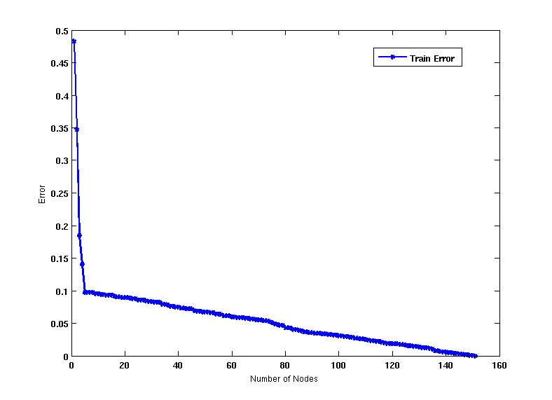
Increasing number of nodes in Decision Trees

Slide 5
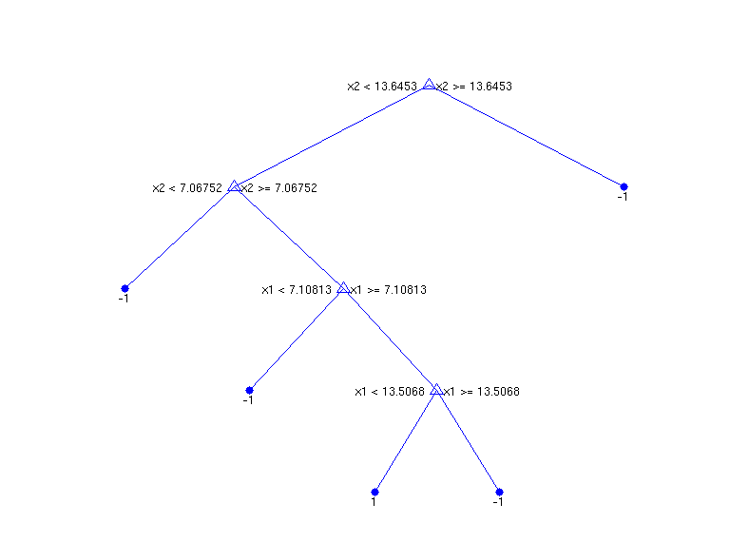
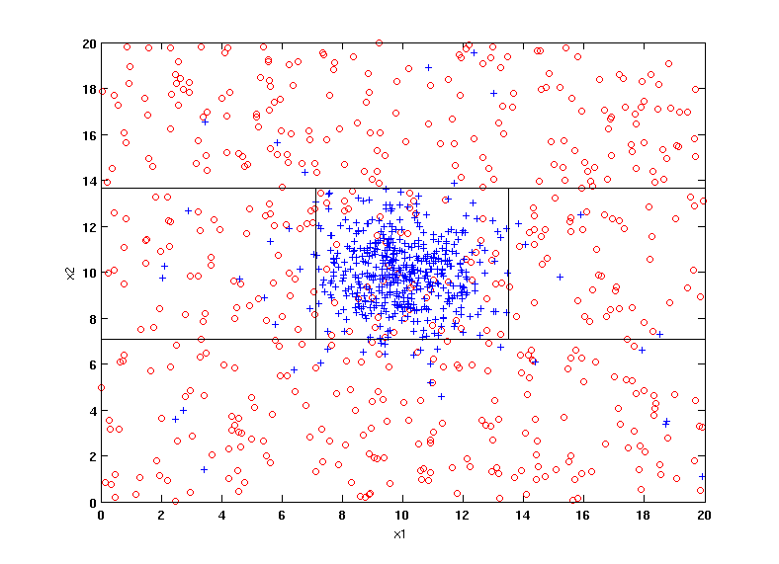
Decision Tree with 4 nodes
Decision Tree
Decision boundaries on Training data

Slide 6
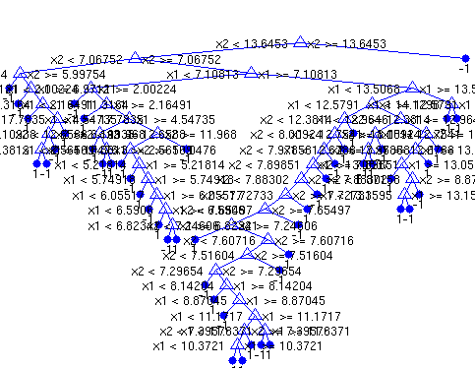
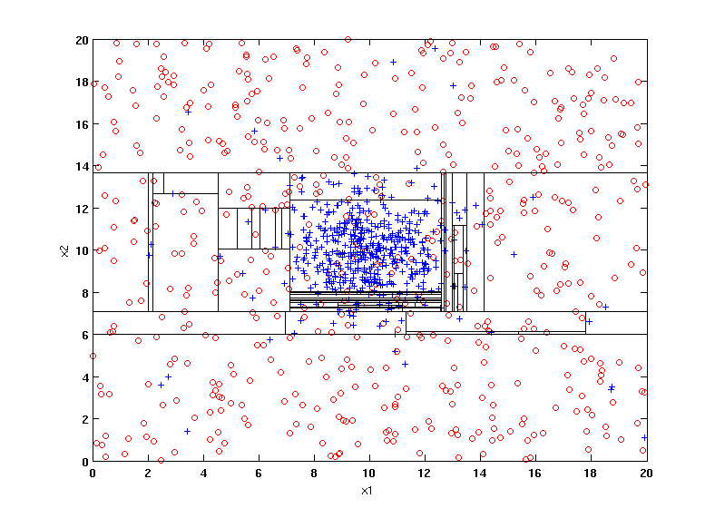
Decision Tree with 50 nodes
Decision Tree
Decision Tree
Decision boundaries on Training data

Slide 7
Which tree is better?
Decision Tree with 4 nodes
Which tree is better ?
Decision Tree with 50 nodes

Slide 8
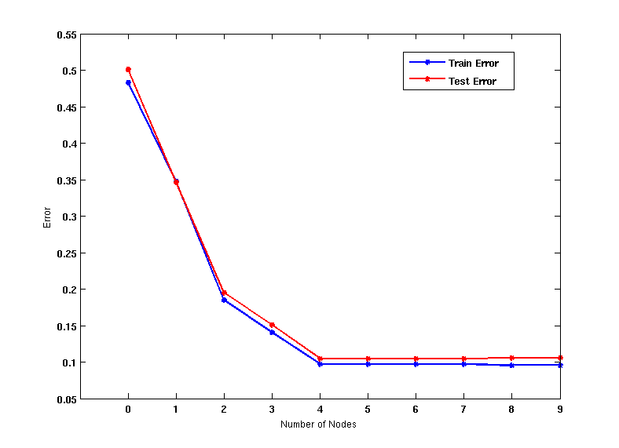
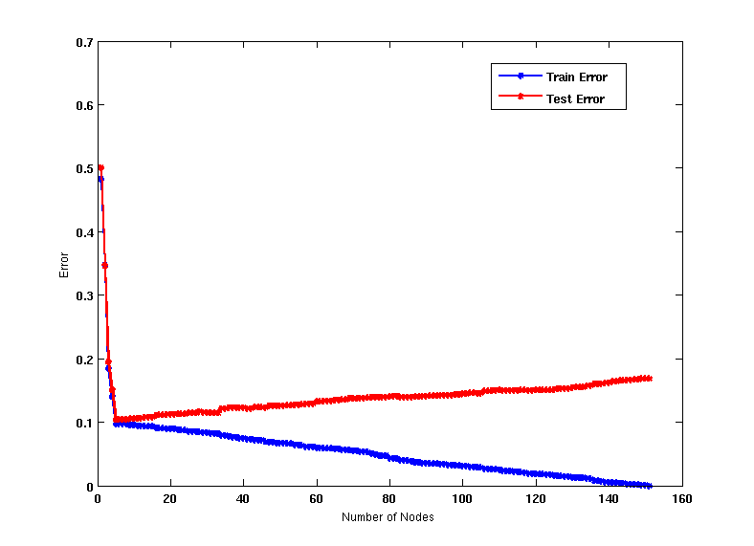
Model Overfitting
Underfitting: when model is too simple, both training and test errors are large
Overfitting: when model is too complex, training error is small but test error is large

Slide 9
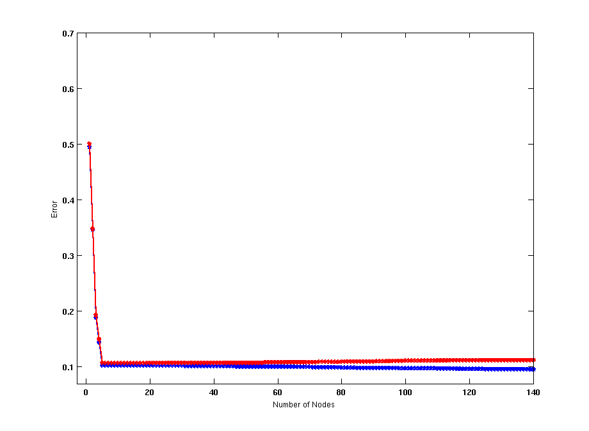
Model Overfitting
Using twice the number of data instances
If training data is under-representative, testing errors increase and training errors decrease on increasing number of nodes
Increasing the size of training data reduces the difference between training and testing errors at a given number of nodes

Slide 10
Reasons for Model Overfitting
Presence of Noise
Lack of Representative Samples
Multiple Comparison Procedure

Slide 11
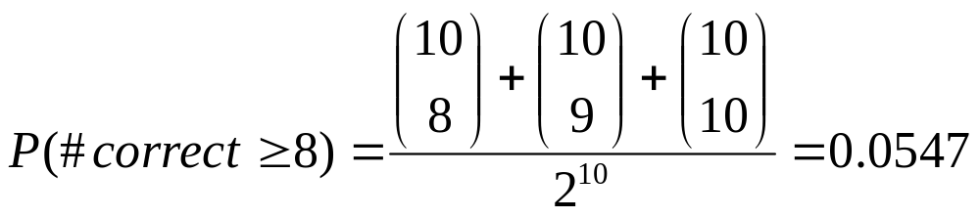
Effect of Multiple Comparison Procedure
Consider the task of predicting whether stock market will rise/fall in the next 10 trading days
Random guessing:
  P(correct) = 0.5
Make 10 random guesses in a row:
Day 1 | Up
Day 2 | Down
Day 3 | Down
Day 4 | Up
Day 5 | Down
Day 6 | Down
Day 7 | Up
Day 8 | Up
Day 9 | Up
Day 10 | Down

Slide 12
Effect of Multiple Comparison Procedure
Approach:
  Get 50 analysts
  Each analyst makes 10 random guesses
  Choose the analyst that makes the most number of correct predictions
Probability that at least one analyst makes at least 8 correct predictions

Slide 13
Effect of Multiple Comparison Procedure
Many algorithms employ the following greedy strategy:
  Initial model: M
  Alternative model: M’ = M ∪ γ,
  where γ is a component to be added to the model (e.g., a test condition of a decision tree)
  Keep M’ if improvement, Δ(M,M’) > α
Often times, γ is chosen from a set of alternative components, Γ = {γ₁, γ₂, …, γ_{k}}
If many alternatives are available, one may inadvertently add irrelevant components to the model, resulting in model overfitting

Slide 14
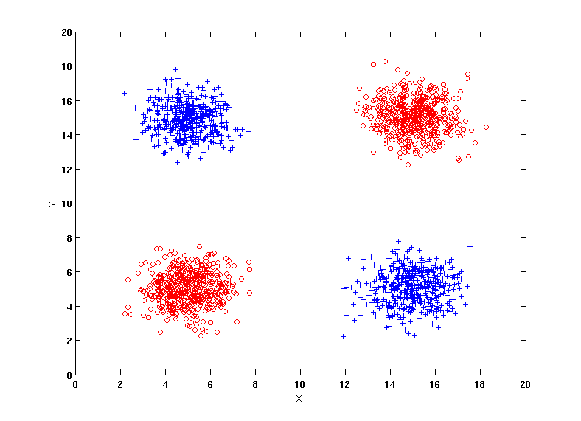
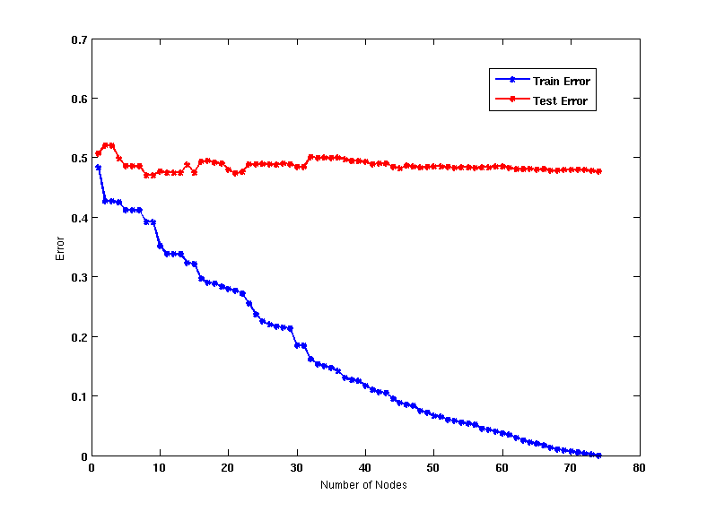
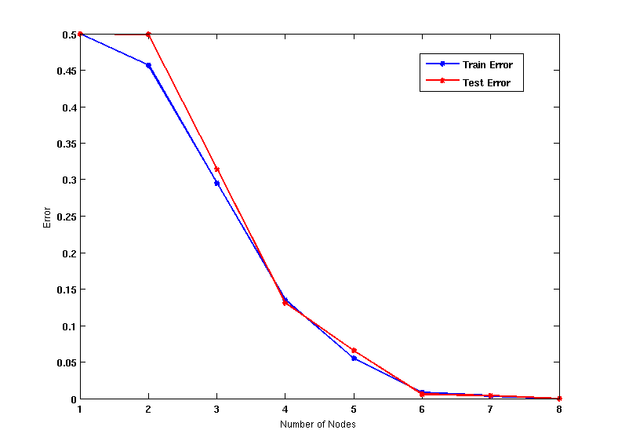
Effect of Multiple Comparison - Example
Use additional 100 noisy variables generated from a uniform distribution along with X and Y as attributes.
Use 30% of the data for training and 70% of the data for testing
Using only X and Y as attributes

Slide 15
Notes on Overfitting
Overfitting results in decision trees that are more complex than necessary
Training error does not provide a good estimate of how well the tree will perform on previously unseen records
Need ways for estimating generalization errors

Slide 16
Estimating Generalization Errors
Resubstitution Estimate
Incorporating Model Complexity
Use Validation Set

Slide 17
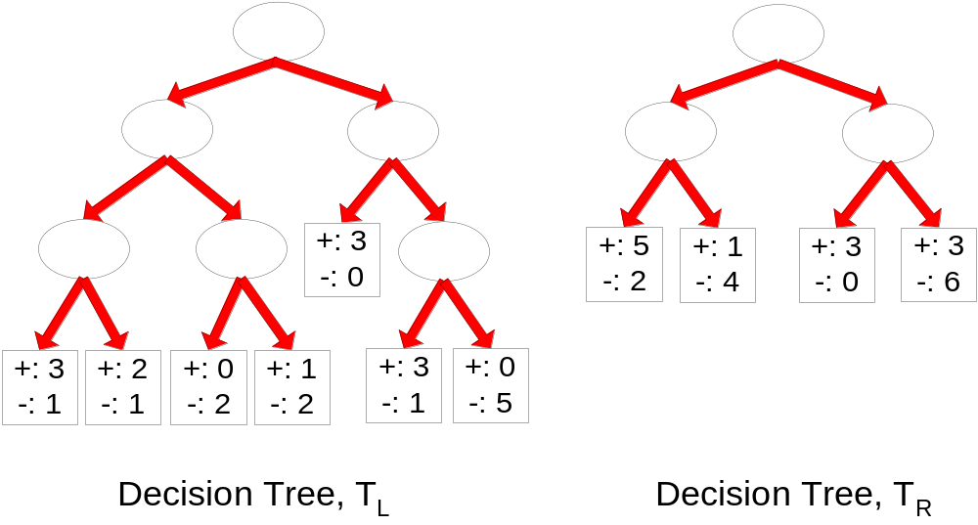
Resubstitution Estimate
Using training error as an optimistic estimate of generalization error
e(T_{L}) = 4/24
e(T_{R}) = 6/24

Slide 18
Incorporating Model Complexity
Rationale: Occam’s Razor
  Given two models of similar generalization errors, one should prefer the simpler model over the more complex model
  A complex model has a greater chance of being fitted accidentally by errors in data
  Therefore, one should include model complexity when evaluating a model

Slide 19
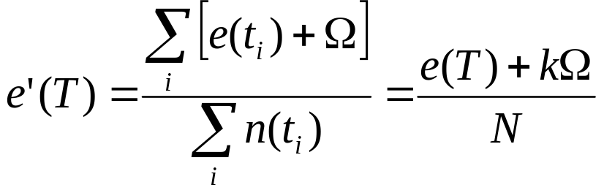
Pessimistic Estimate
Given a leaf node t_{i} in a decision tree
  n(t_{i}): number of training records at node t_{i}
  e(t_{i}): number of records misclassified at node t_{i}
  Pessimistic Error Estimate of decision tree T with k leaf nodes:
    Ω: is the cost of adding a leaf node
    N: total number of training records

Slide 20
Pessimistic Estimate
e(T_{L}) = 4/24
e(T_{R}) = 6/24
Ω = 1
e’(T_{L}) = (4 +7 × 1)/24 = 11/24 = 0.458
e’(T_{R}) = (6 + 4 × 1)/24 = 10/24 = 0.417

Slide 21
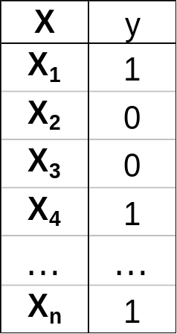
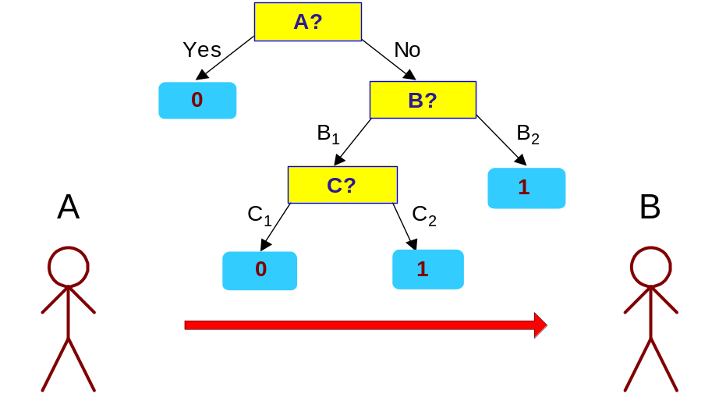
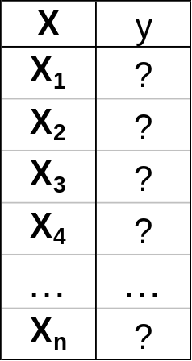
Minimum Description Length (MDL)
Cost(Model,Data) = Cost(Data|Model) + Cost(Model)
  Cost is the number of bits needed for encoding.
  Search for the least costly model.
Cost(Data|Model) encodes the misclassification errors.
Cost(Model) uses node encoding (number of children) plus splitting condition encoding.

Slide 22
Using Validation Set
Divide training data into two parts:
  Training set:
    use for model building
  Validation set:
    use for estimating generalization error
    Note: validation set is not the same as test set
Drawback:
  Less data available for training

Slide 23
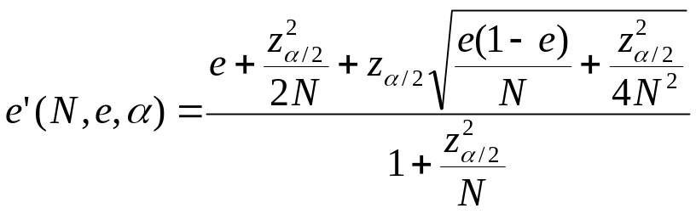
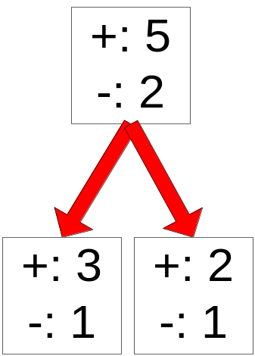
Estimating Statistical Bounds
Before splitting: e = 2/7, e’(7, 2/7, 0.25) = 0.503
e’(T) = 7 × 0.503 = 3.521
After splitting:
e(T_{L}) = 1/4, e’(4, 1/4, 0.25) = 0.537
e(T_{R}) = 1/3, e’(3, 1/3, 0.25) = 0.650
e’(T) = 4 × 0.537 + 3 × 0.650 = 4.098
Therefore, do not split

Slide 24
Handling Overfitting in Decision Tree
Pre-Pruning (Early Stopping Rule)
  Stop the algorithm before it becomes a fully-grown tree
  Typical stopping conditions for a node:
    Stop if all instances belong to the same class
    Stop if all the attribute values are the same
  More restrictive conditions:
    Stop if number of instances is less than some user-specified threshold
    Stop if class distribution of instances are independent of the available features (e.g., using χ ² test)
    Stop if expanding the current node does not improve impurity
    measures (e.g., Gini or information gain).
    Stop if estimated generalization error falls below certain threshold

Slide 25
Handling Overfitting in Decision Tree
Post-pruning
  Grow decision tree to its entirety
  Subtree replacement
    Trim the nodes of the decision tree in a bottom-up fashion
    If generalization error improves after trimming, replace sub-tree by a leaf node
    Class label of leaf node is determined from majority class of instances in the sub-tree
  Subtree raising
    Replace subtree with most frequently used branch

Slide 26
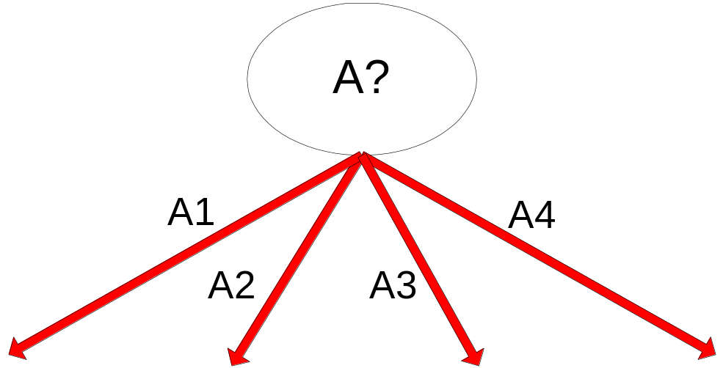
Example of Post-Pruning
Training Error (Before splitting) = 10/30
Pessimistic error = (10 + 0.5)/30 = 10.5/30
Training Error (After splitting) = 9/30
Pessimistic error (After splitting)
= (9 + 4 × 0.5)/30 = 11/30
PRUNE!
Class = Yes | 20
Class = No | 10
Error = 10/30
Class = Yes | 8
Class = No | 4
Class = Yes | 3
Class = No | 4
Class = Yes | 4
Class = No | 1
Class = Yes | 5
Class = No | 1

Slide 27
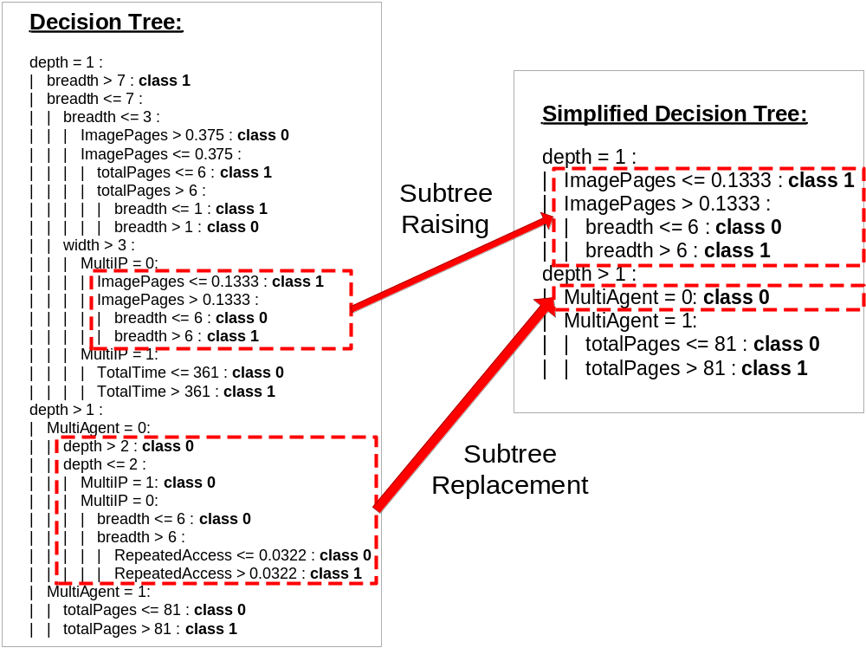
Examples of Post-pruning

Slide 28
Evaluating Performance of Classifier
Model Selection
  Performed during model building
  Purpose is to ensure that model is not overly complex (to avoid overfitting)
  Need to estimate generalization error
Model Evaluation
  Performed after model has been constructed
  Purpose is to estimate performance of classifier on previously unseen data (e.g., test set)

Slide 29
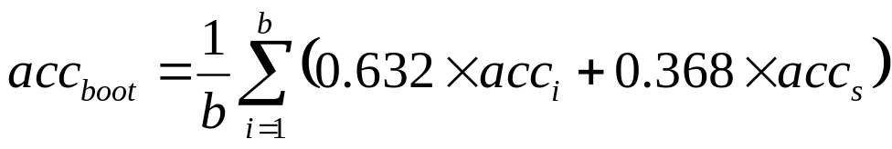
Methods for Classifier Evaluation
Holdout
  Reserve k% for training and (100-k)% for testing
Random subsampling
  Repeated holdout
Cross validation
  Partition data into k disjoint subsets
  k-fold: train on k-1 partitions, test on the remaining one
  Leave-one-out: k=n
Bootstrap
  Sampling with replacement
  .632 bootstrap:

